Slide 1
FINANCES FOR
THE FUTURE
Gaby Goldberg, Glynnis Millhouse, and Pierce Lowary

Slide 2
Problem Domain
Budgeting for
the Future

Slide 3
From last time...
People have a vision of their ideal financial future, but have trouble mapping their way there. They can’t see how the tectonic plates of home, career, family, and investments fit together into a financially sound life.
People entering or about to enter their 30s have to quickly shift the way they manage their money in order to accommodate kids, a higher cost of living, owning a home, etc.
There is unease about finances. Some people deal with this by not investigating, while others deal with it by modeling decisions in tools like Excel, despite them often being difficult to use.

Slide 4
Additional Needfinding Interviews
Tara
Daniel
Sarah

Slide 5
We learned...
There’s a broad range of anxiety about finances, often stemming from childhood
“I grew up poor, and even though I now have a six figure job, that will always be a part of how I feel about money. I worry about sliding back.” - Sarah
Interest in whether one’s own spending is “ok” is higher amongst interviewees who are more anxious
“I never look at or worry about my budget. My family has a financial planner in New York City that I could contact, but I just haven’t because I know it will be a lot of work.” - Tara
“I know what kind of apartment I want to buy because of my friends. I grew up in a family that emphasized frugality, so I don’t want to be spending more than my friends. That would make me feel wasteful.” - Daniel

Slide 6
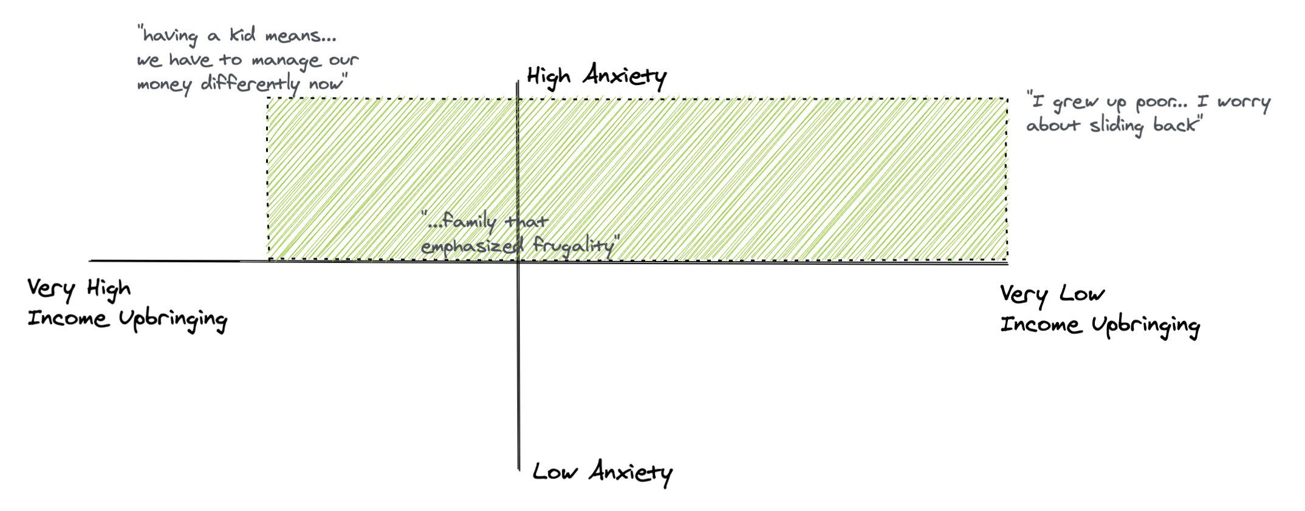
Focus

Slide 7
POV #1
We Met...
Dan, who moved to a new city and was surprised by the higher rent
We Were Amazed to Realize...
Dan benchmarks his spending against what he perceives his friends spend, but doesn’t talk about budget explicitly with them
It Would Be Game-Changing To…
Help Dan feel confident that his spending is on-par with his friends without making him feel like he is being intrusive or jeopardizing his relationships

Slide 8
POV #2
We Met...
Johanna, who dreams of one day being financially independent
We Were Amazed to Realize...
In her 20s, Johanna found the house she wants to buy one day, calculated how much she needed to save each month, and has stuck to her savings goal for a decade. But her analysis breaks down when talking about children, as it adds too much complexity. This makes her feel unsure if she’ll reach her goal.
It Would Be Game-Changing To…
Empower Johanna to reach her goal using all the factors that matter

Slide 9
Lots of HMWs...
HMW help Brian prepare to move to a big city?
HMW help Rob feel confident about his family’s financial future?
HMW make family finances feel rewarding and inspiring?
HMW make it comfortable to share spending habits with friends?
HMW help Sarah feel it’s unlikely she’ll be poor again?
HMW reduce the stress of planning across multiple continents?
HMW question whether financial freedom will make Sarah happy?
HMW create a definition of what financial freedom really means?
HMW make a tool like Excel more intuitive?
HMW use data to help Sarah’s goals track changing financial conditions?
HMW go about telling millennials what they “should” be spending?
HMW help Sarah see her net worth in a single place?

Slide 10
3 Best HMWs
How might we...
make family finances feel rewarding, empowering, and inspiring?
help Sarah feel more confident about money?
bring Dan and his friends closer using finances, vs. push them apart?

Slide 11
Lots of ideas...
Visualize putting every dollar to “work”
Set reminders, e.g. “Put away X% of paycheck each month”
Let people set incremental goals and reward them
Financial therapy course online
Financial plans from financial celebrities, like Warren Buffett
Progress bar to see how close you are to your goal
Make an avatar of “future you” with encouragement to stay on track
Mint + intelligence layer based on what other people are spending
Ad-based surveys, e.g. “How much did you spend on coffee this week?
Ask millennials how much they think their friends spend
Collect data on spending from online shopping, social media, etc.
Peer mentorship group to talk about finances

Slide 12
3 Best Ideas
Create a social “DietBet”-style game where friends pool $X at the start of the month, and whoever reaches a savings/budgeting goal gets the money
Enter spending anonymously to see how you stack up against your peers
Have curated financial plans from famous financial celebrities, like Warren Buffett, that people follow (“You are 30% done on the Buffet plan”)

Slide 13
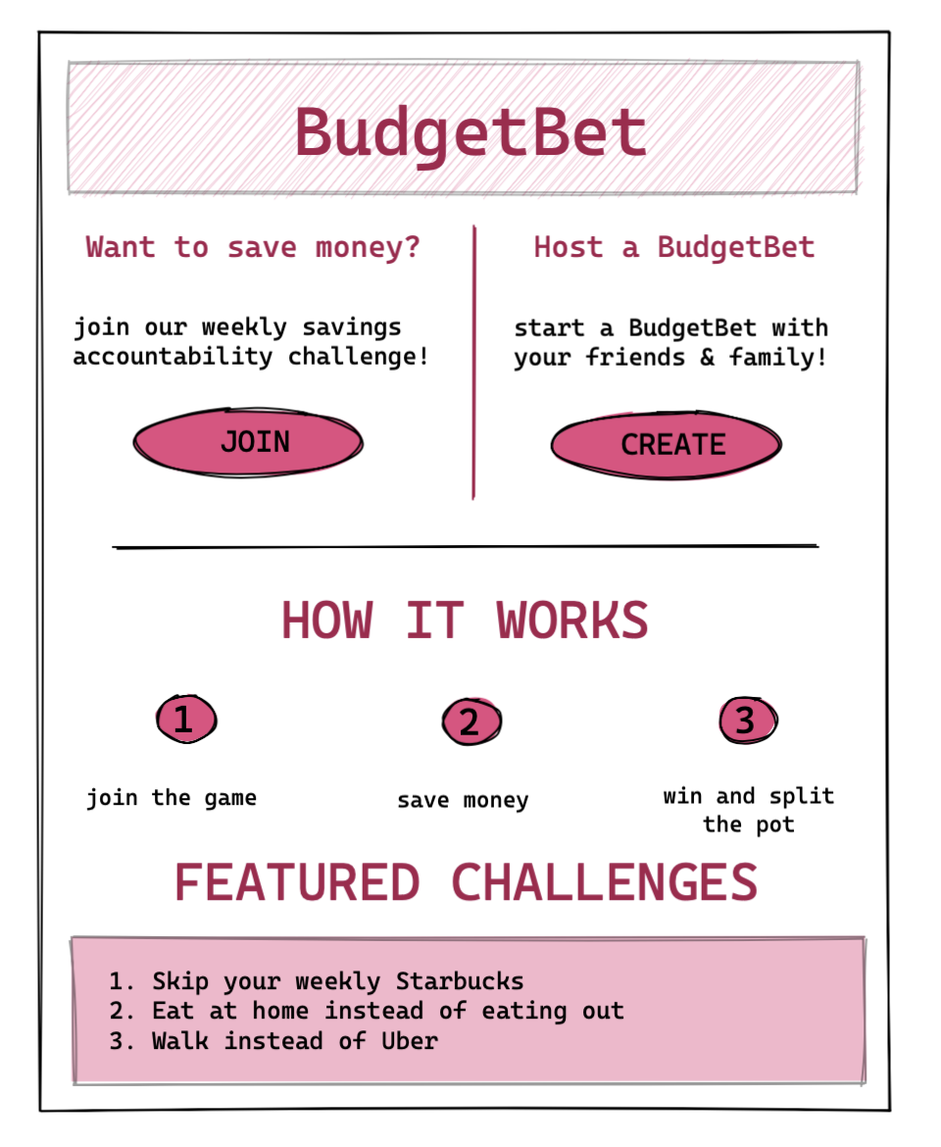
Idea #1
Social “DietBet”-style game
- The context of a game will help people feel more comfortable talking about money
- Gamifying budgeting will make it more engaging
- People want to save enough to join a BudgetBet

Slide 14
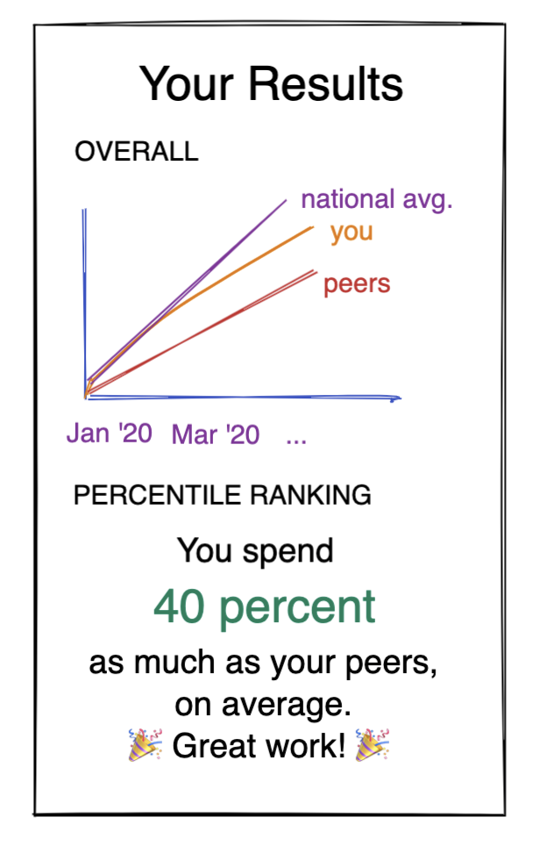
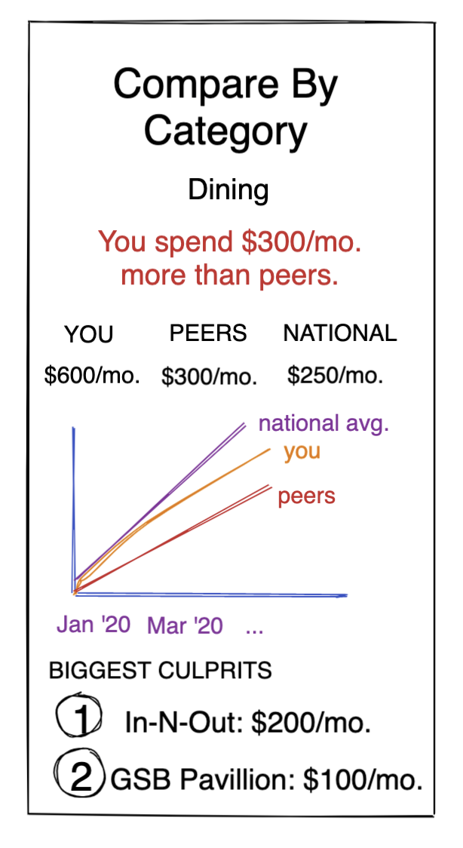
Idea #2
See how you stack up
- People are interested in what their peers spend
- Knowing how they rank will make them feel good or inspired to take action - not cause apathy
- People will trust the data even if the “pool” they are ranked in is anonymous

Slide 15
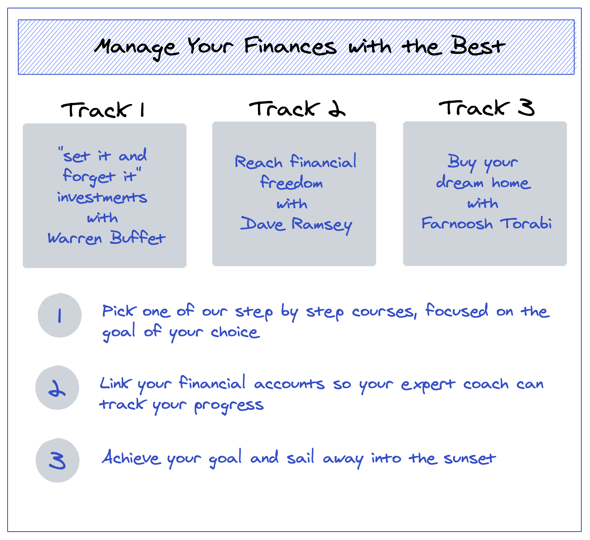
Idea #3
Curated financial celebrity plans
- An expert personality will make people feel less anxious about whether the plan will work out
- There is more trust in financial personalities vs. under-the-radar expertise
- People want a step-by-step journey

Slide 16
Experience Interviews
Harry
Bader
Sacha

Slide 17
BudgetBet
We learned...
“I probably wouldn’t use this because I’m not trying to save money”
“This seems misaligned because if you don’t save well, you lose even more money”
“This is a good idea,” but I’d prefer something like Acorns because it’s more automatic.

Slide 18
Peer Stackup
We learned...
“Would be interesting to see, but not sure it would change my spending habits… I’m a single guy with no family and make plenty of money”
“For dining, I already know what I spend historically and I know what’s normal. For childcare, this would be interesting because it’s a big change in my spending.”

Slide 19
Celebrity Class
We learned...
- Like that it’s not a robo-advisor, that you get to implement the changes yourself and as you see fit
- Don’t necessarily need “celebrity” to build trust. Could be a normal financial advisor.
- Still, celebrities can provide a sense of cachet and garner interest in the product, especially among younger generations.

